Slide 1

Forcasting Temprature Using Machine learning
Imran
Mobile Computing Lab

Slide 2
Temperature forecasting
Temperature forecasting is one of the most important elements of weather forecasting
I consider Particulate Matter (PM2.5 and PM10), temperature, humidity and pressure as measuring factors

Slide 3
Experimental Setup
Sensors: Nova Dust Sensor and BME 280 Sensor
Raspberry PI
Python (Anaconda)
https://www.youtube.com/watch?v=ZnjTvw6Tuy8

Slide 4
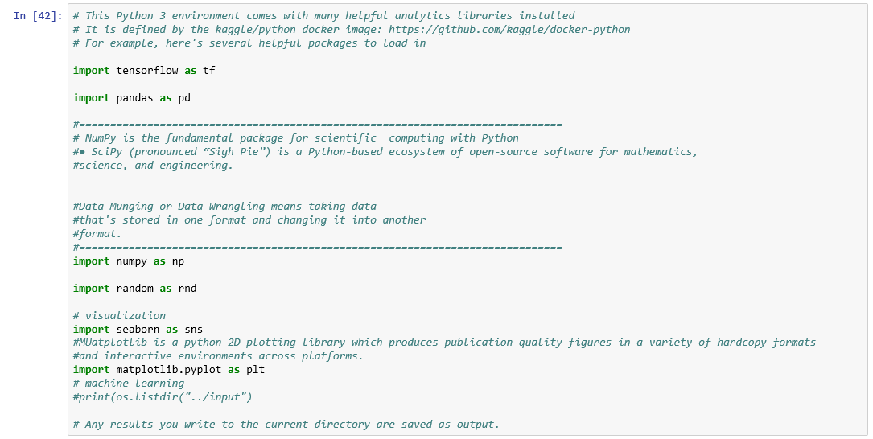
Libraries

Slide 5
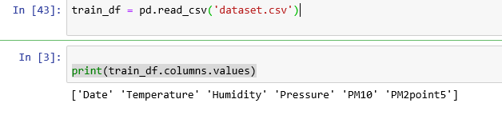
Importing datset

Slide 6
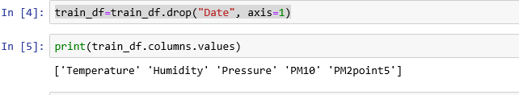

Slide 7
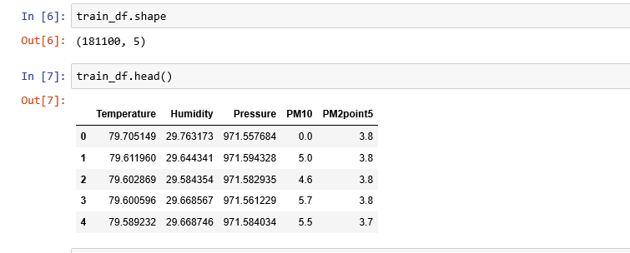

Slide 8
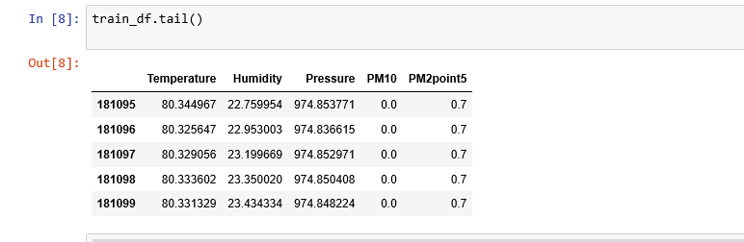

Slide 9
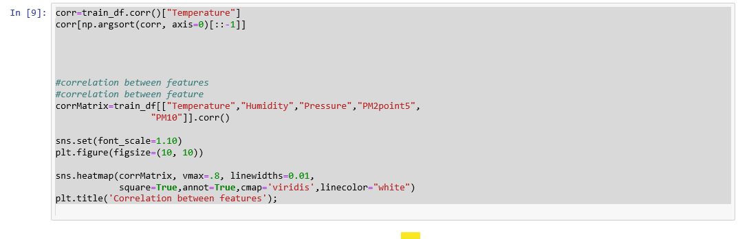

Slide 10
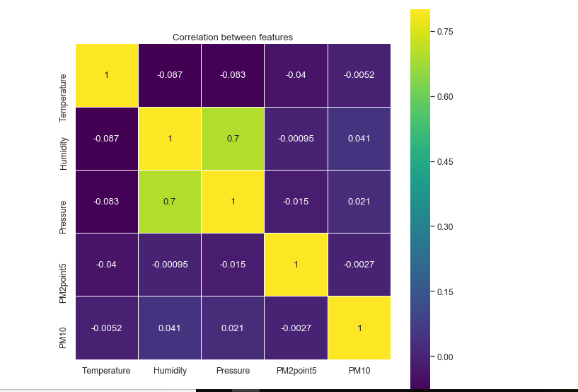

Slide 11
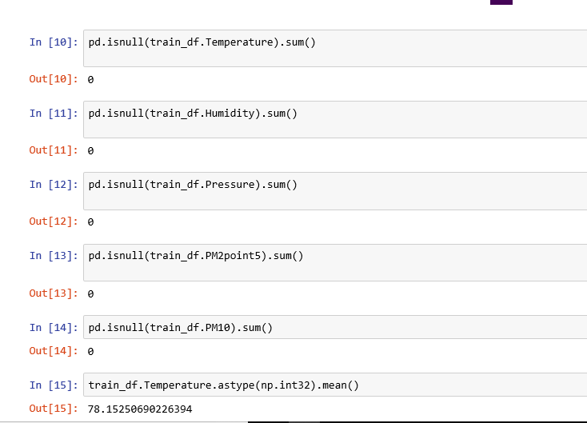

Slide 12
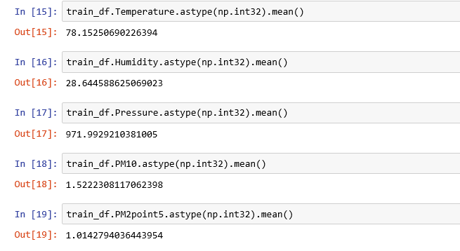

Slide 13
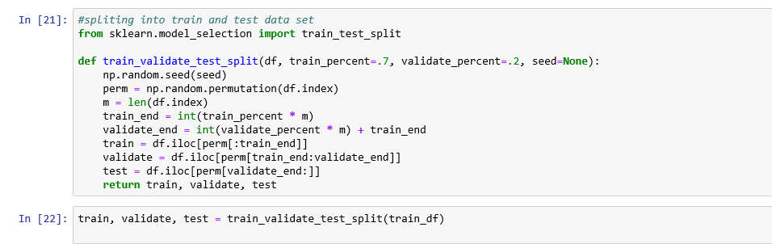

Slide 15
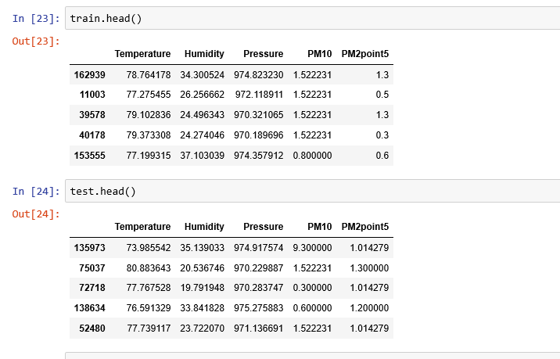

Slide 17
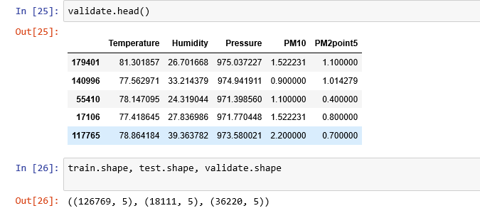

Slide 18
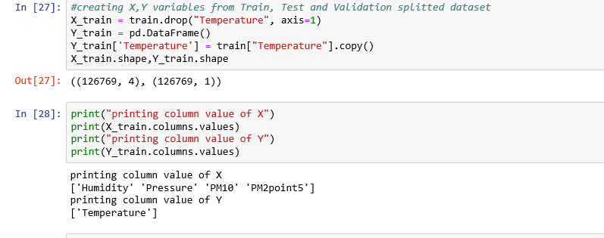

Slide 19
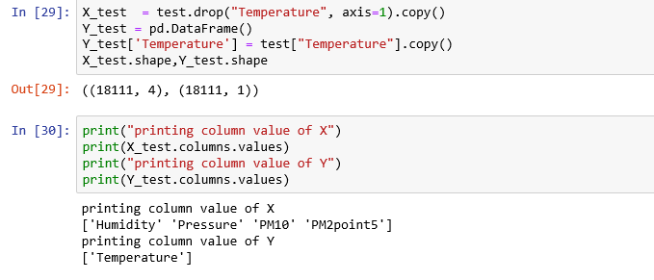

Slide 20
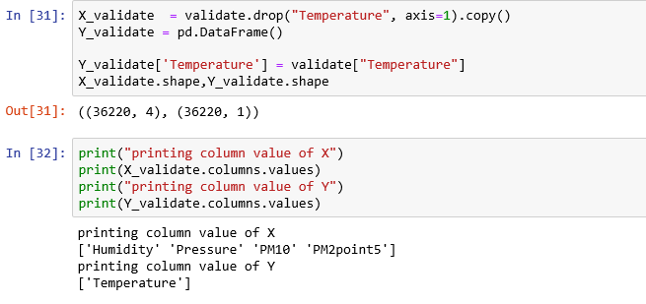

Slide 21
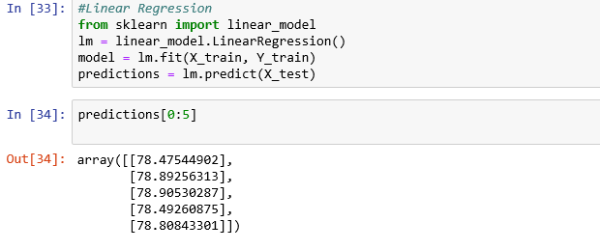
Linear Regression

Slide 22
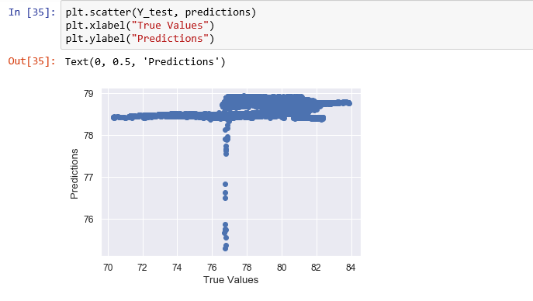
Linear Regression

Slide 23
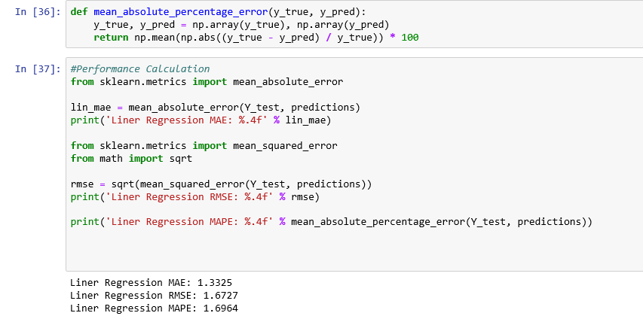
Linear Regression

Slide 24
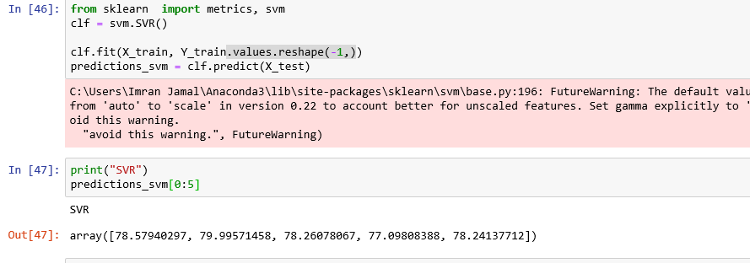
Support Vector Regression

Slide 25
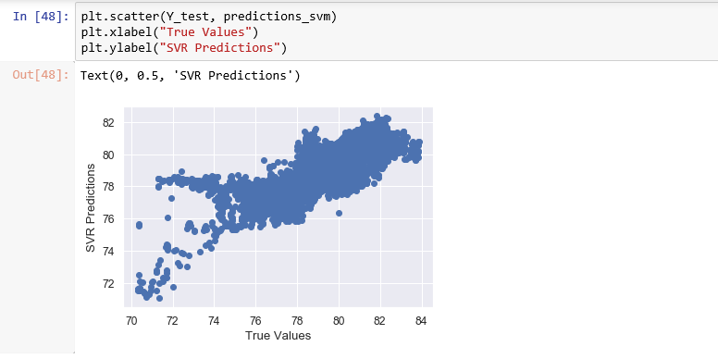
Support Vector Regression

Slide 26
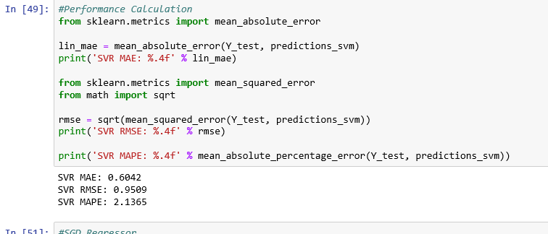
Support Vector Regression

Slide 27
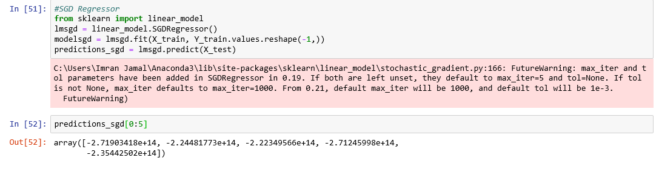
Stochastic Gradient Descent Regression

Slide 28
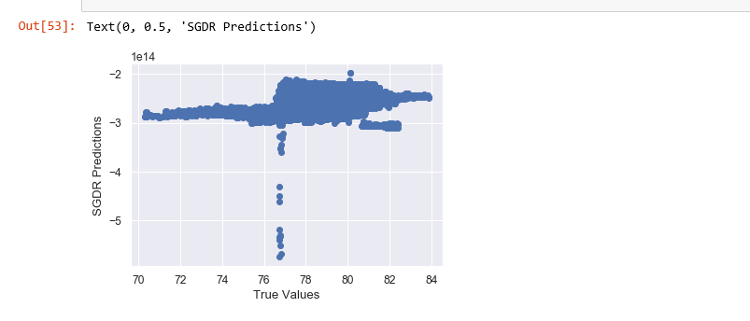
Stochastic Gradient Descent Regression

Slide 29
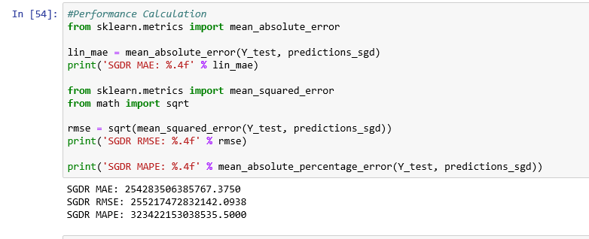
Stochastic Gradient Descent Regression

Slide 30
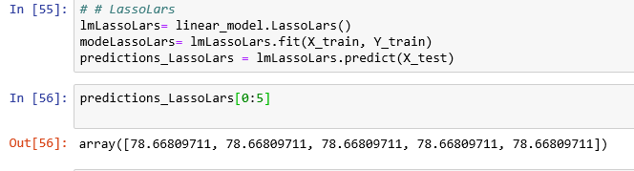
LassoLars Regression

Slide 31
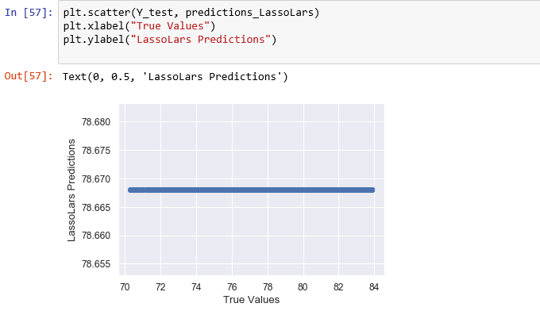
LassoLars Regression

Slide 32
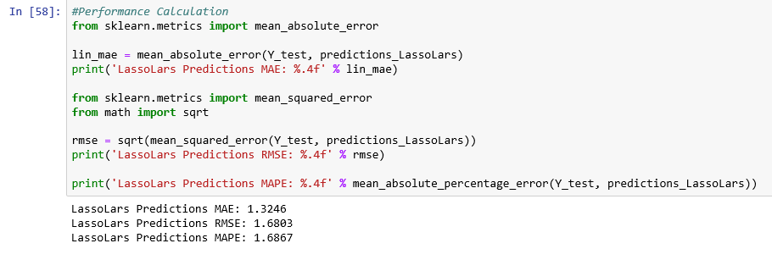
LassoLars Regression

Slide 33
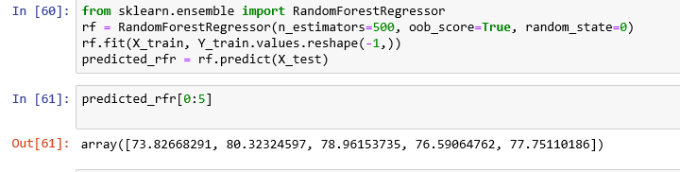
Random Forest Regression

Slide 34
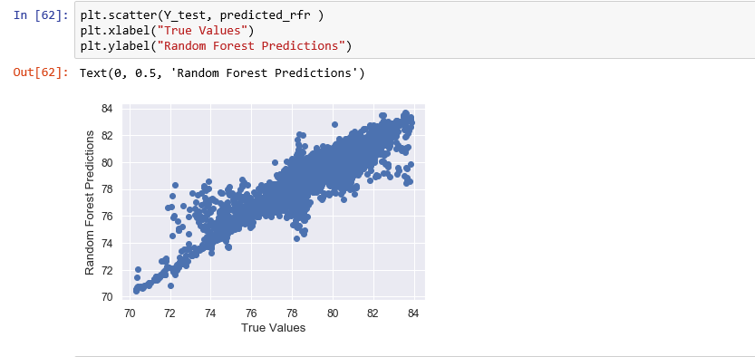
Random Forest Regression

Slide 35
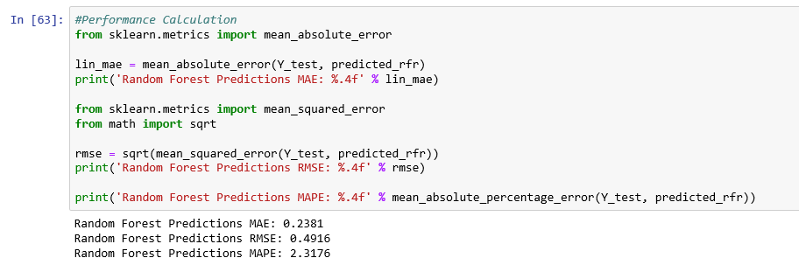
Random Forest Regression

Slide 36
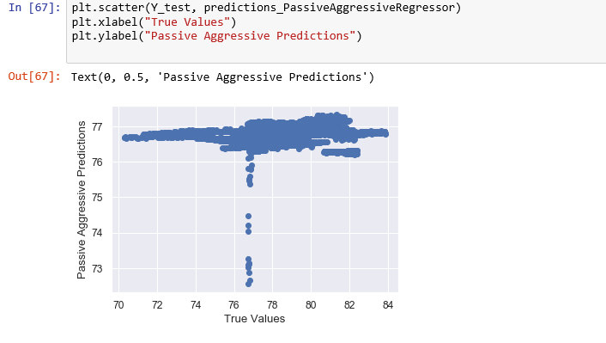
Passive Aggressive Regression

Slide 37
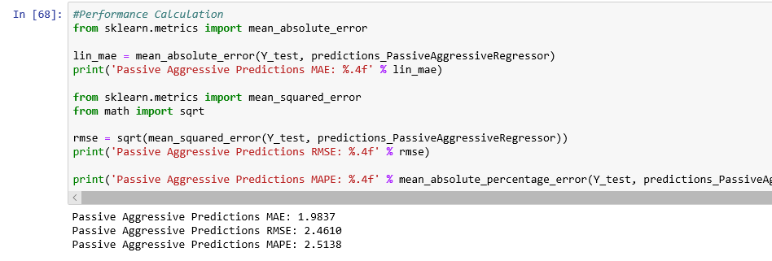
Passive Aggressive Regression

Slide 38
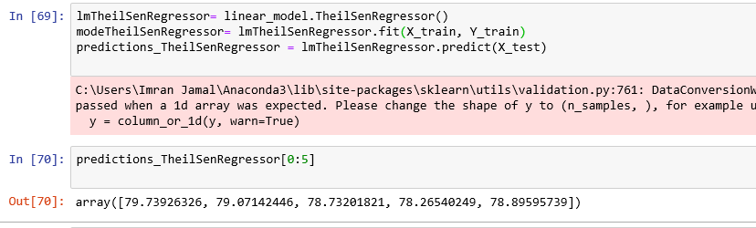
TheilSen Regression

Slide 39
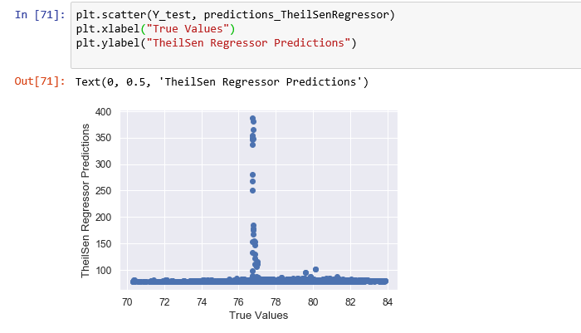
TheilSen Regression

Slide 40
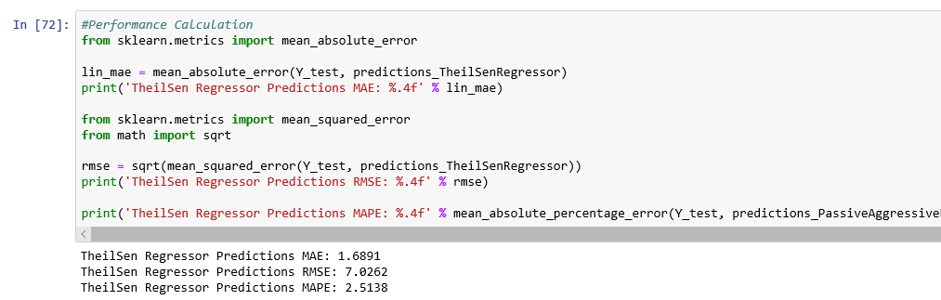
TheilSen Regression

Slide 41
Model | MAE | RMSE | MAPE
Stochastic Gradient Descent Regressor | 254283506385767.3750 | 255217472832142.0938 | 323422153038535.5000
LassoLars Regressor | 1.3246 | 1.6803 | 1.6867
Random Forest Regressor | 0.2381 | 0.4916 | 2.3176
Passive Aggressive Regressor | 1.9837 | 2.4610 | 2.5138
TheilSen Regressor | 1.6891 | 7.0262 | 2.5138
SVR | 0.6042 | 0.9509 | 2.1365
Liner Regression | 1.3325 | 1.6727 | 1.6964

Slide 42
Thank you ☺ Resources and Kernels
Kernal Link:
https://www.kaggle.com/imranjamal/forcasting-temprature-using-machine-learning/

